Slide 1
Exam II Review Processing Materials
David C. Martin MSEG 302
The University of Delaware

Slide 2
Exam II
Chapter 8: Fracture and Failure: HW #7
Chapter 9: Phase Diagrams:
Chapter 10: Phase Transformations, Fe-C alloys: HW#8
Chapter 12: Ceramics
Chapter 15: Polymers: Processing: HW #9
Materials Processing Techniques

Slide 3

Chapter 8: Fracture and Failure
Stress concentrations at cracks
Critical stress for crack propagation
Fracture toughness
Impact testing
Fatigue testing: S-N curves, da/dN vs. ΔK
Creep
Steady-state creep:
$$K ≥ K_{Ic}=Yσ\sqrt{πa}$$

Slide 4
Chapter 9: Phase Diagrams
Show stable phases at composition, temperature
Solubility limits, relative amounts, melting, precipitation, transitions
Single phase solutions, two-phase mixtures
Compositions, lever rule for amounts in two-phase regions
Eutectic, eutectoid, peretectic, peritectoid
Composition variations (coring) during cooling
Phase transformations, Fe-C phase diagram near eutectoid

Slide 5
Chapter 10: Phase Transformations
Fastest rates at optimal amounts of undercooling
Larger structures at higher temperatures, but takes longer
Fe-C (steel):
Austenite (FCC above eutectoid)
Coarse Pearlite (ferrite + cementite layers, large)
Fine Pearlite (ferrite + cementite layers, small)
Bainite (lath or needle shaped ferrite + cementite)
Martensite (BCT, diffusionless, hard and brittle)
Tempered Martensite
Spheroidite (after extended annealing)
Hypoeutectoid: pro-eutectoid ferrite
Hypereutectoid: pro-eutectoid cementite

Slide 6
Chapter 12: Ceramics
Anions and cations, strong bonds, brittle and hard
Coordination, relative sizes
Density, structure
Crystals, layers, other structures possible
Defects: need to maintain charge neutrality
Phase diagrams to describe stability, structures

Slide 7
Polymer properties and processing
Time-temperature dependent properties
Molecular weight, crystallinity, crosslinking
Orientation, drawing
Additives
Processing techniques

Slide 8
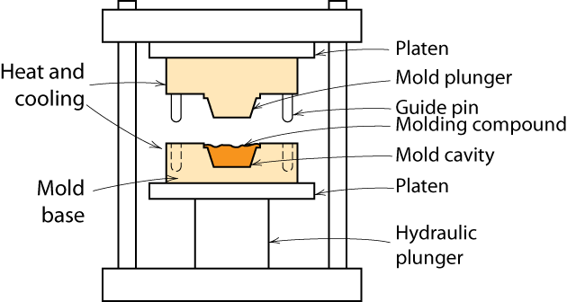
Processing Plastics - Molding
Compression and transfer molding
thermoplastic or thermoset
Notes:
Male & female parts to mold

Slide 9
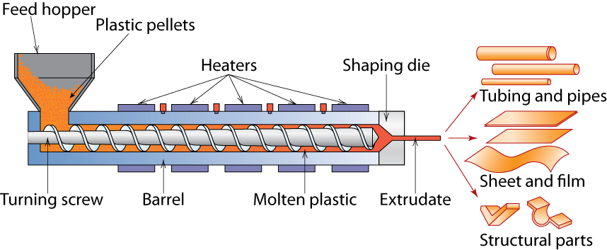
Processing Plastics – Extrusion
Notes:
An extruder is a device that used a large screw to melt a polymer, compress it, & force it into a mold
Extremely commonly used

Slide 10
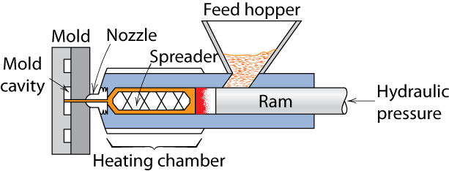
Processing Plastics - Molding
Injection molding
thermoplastic & some thermosets
Notes:
Polymer is melted in chamber & then the molten polymer is forced under pressure into the die

Slide 11
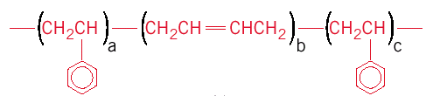
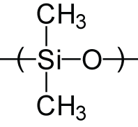
Polymer Types: Elastomers
Elastomers – rubber
Crosslinked materials
Natural rubber
Synthetic rubber and thermoplastic elastomers
SBR- styrene-butadiene rubber
styrene
styrene
butadiene
– Silicone rubber

Slide 12
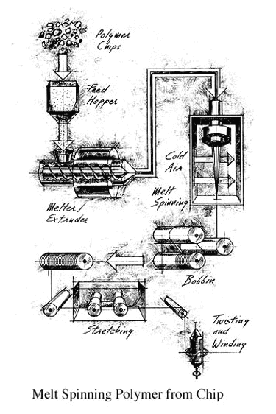
Polymer Types: Fibers
Fibers – have length/diameter >100
Textiles, reinforcements
Formed by spinning
Extrude polymer through a spinnerette
May be done from the melt, or from solution

Slide 13
Fiber spinning
Melt spinning
From the melt, only need to cool
Fastest, requires thermoplastics: PE, PP, PET, Nylons
Wet spinning
From solution, coagulate in non-solvent
Rayon (functionalized cellulose)
Dry spinning
From solution, evaporate solvent
MPDI (Nomex)
Dry-Jet Wet spinning
From liquid crystal solution
PPTA (Kevlar)
Gel spinning
From a solidified (crystallized) dilute solution
UHMWPE (Spectra)

Slide 14
Polymer Types
Coatings – thin film on surface – i.e. paint, varnish
To protect item
Improve appearance
Electrical insulation
Adhesives – produce bond between two adherands
Usually bonded by:
Secondary bonds
Mechanical bonding
Foams – gas bubbles in plastic
Films – blown film extrusion

Slide 15
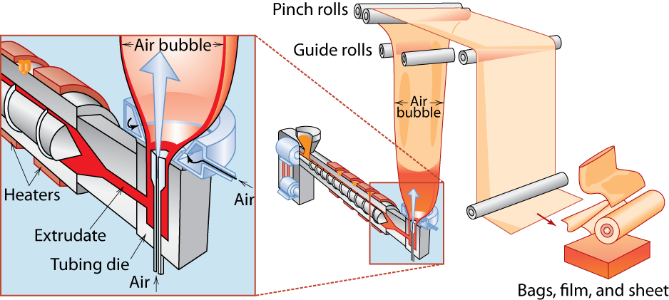
Blown-Film Extrusion

Slide 16
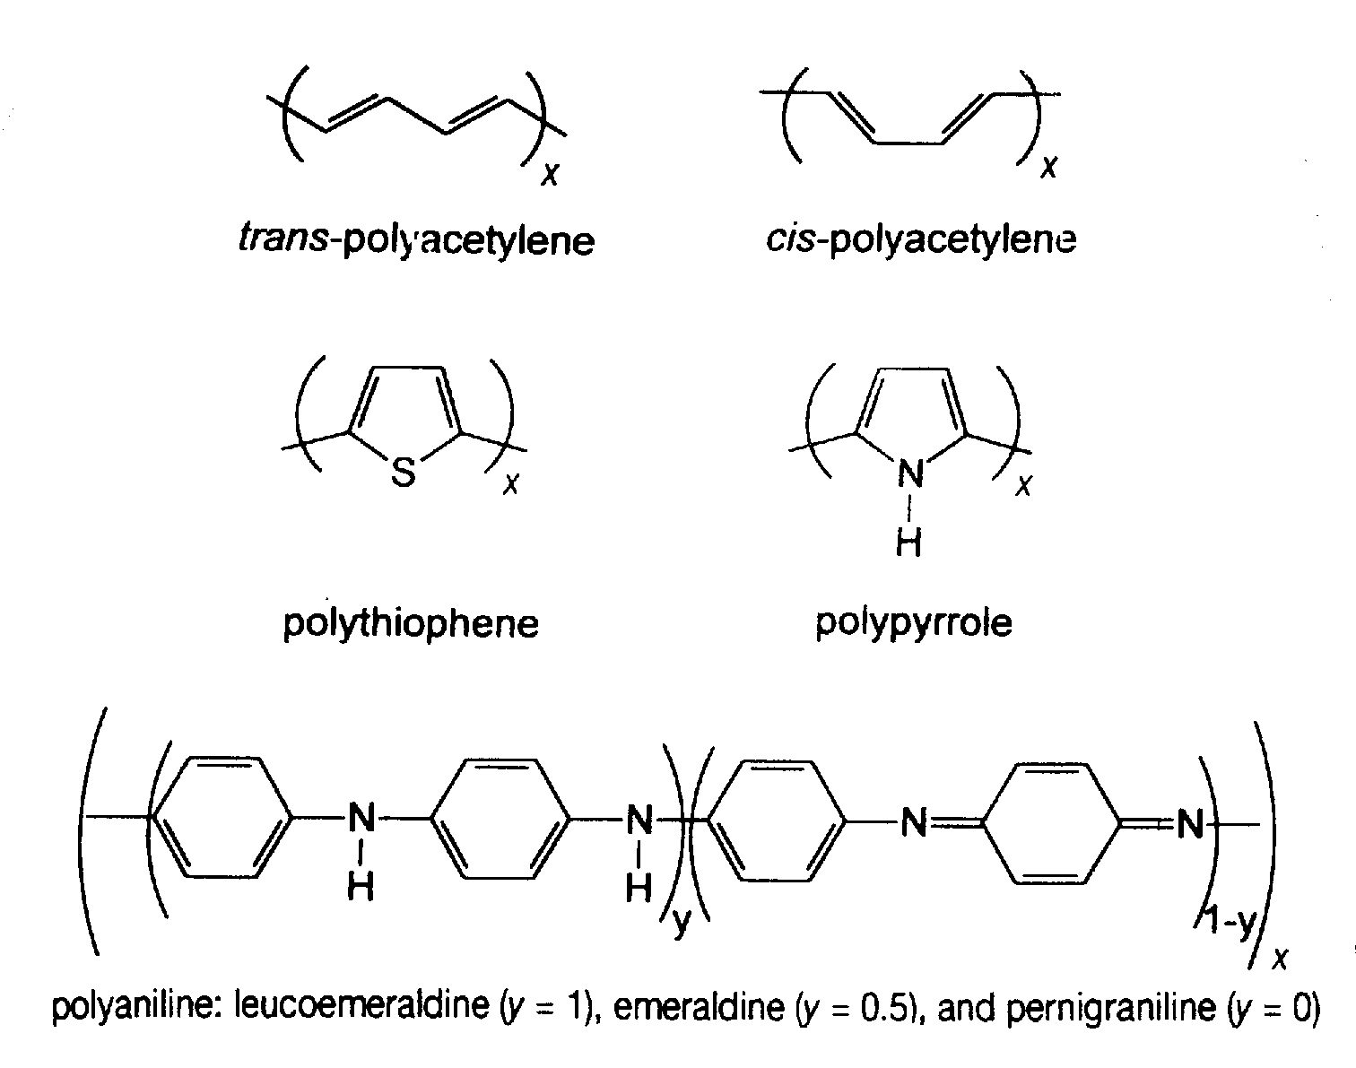
Conjugated, Conducting Polymers
Sensors
Actuators
Displays
Both electronic
and ionic
conduction

Slide 17
Summary
• General drawbacks to polymers:
-- E, σy, Kc, Tapplication are generally (but not always) small.
-- Deformation is often T and time dependent.
-- Result: polymers benefit from composite reinforcement.
• Thermoplastics (PE, PS, PP, PC):
-- Smaller E, σy, Tapplication
-- Larger Kc
-- Easier to form and recycle
• Elastomers (rubber):
-- Large reversible strains!
• Thermosets (epoxies, polyesters):
-- Larger E, σy, Tapplication
-- Smaller Kc

Slide 18
Refinement of Iron from Ore
Coke
Iron Ore
Limestone
BLAST FURNACE
heat generation
gas
C
+
O₂
→
CO₂
refractory
vessel
reduction of iron ore to metal
layers of coke
CO₂
+
C
→
2CO
and iron ore
3CO +
Fe₂O₃
→
2Fe
+3CO₂
air
purification
slag
Molten iron
CaCO₃
→
CaO+CO₂
CaO + SiO₂ + Al₂O₃
→
slag
Pig Iron: 3.5-4.5%C (near eutectic)

Slide 19
Bessemer process: reduce carbon content by blowing air on liquid iron
Oxidation reactions release heat, remove carbon
Ladle tipped after conversion to separate from slag (floats)

Slide 20
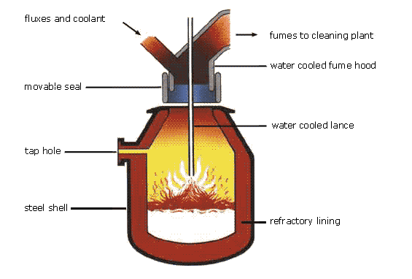
Making steel: Basic Oxygen Furnace

Slide 21
Metal Fabrication
How do we fabricate metals?
Blacksmith - hammer (forged)
Molding - cast
Forming Operations
Rough stock formed to final shape
Hot working vs. Cold working
• T high enough for • well below T_{m} recrystallization work hardening
• Larger deformations • smaller deformations

Slide 22
Metal Fabrication Methods - I
FORMING
CASTING
JOINING
• Forging (Hammering; Stamping)
(wrenches, crankshafts)
• Rolling (Hot or Cold Rolling)
(I-beams, rails, sheet & plate)
force
die
roll
A
often at
elev. T
d
A
o
blank
A
d
A
o
roll
Adapted from Fig. 11.8, Callister 7e.
force
• Drawing
(rods, wire, tubing)
• Extrusion
(rods, tubing)
die
A
o
A
d
container
die holder
A
tensile
force
o
force
ram
billet
extrusion
A
d
die
die
container
die must be well lubricated & clean
ductile metals, e.g. Cu, Al (hot)

Slide 23
Metal Fabrication Methods - II
FORMING
CASTING
JOINING
Casting- mold is filled with metal
metal melted in furnace, perhaps alloying elements added. Then cast in a mold
most common, cheapest method
gives good production of shapes
weaker products, internal defects
good option for brittle materials

Slide 24
Metal Fabrication Methods - II
FORMING
CASTING
JOINING
• Sand Casting
(large parts, e.g.,
auto engine blocks)
trying to hold something that is hot
what will withstand >1600ºC?
cheap - easy to mold => sand!!!
pack sand around form (pattern) of desired shape
Sand
Sand
molten metal

Slide 25
Metal Fabrication Methods - II
FORMING
CASTING
JOINING
• Sand Casting
(large parts, e.g.,
auto engine blocks)
Investment Casting
pattern is made from paraffin.
mold made by encasing in plaster of paris
melt the wax & the hollow mold is left
pour in metal
Sand
Sand
molten metal
• Investment Casting
(low volume, complex shapes
e.g., jewelry, turbine blades)
plaster
die formed
around wax
prototype
wax

Slide 26
Metal Fabrication Methods - II
FORMING
CASTING
JOINING
• Sand Casting
(large parts, e.g.,
auto engine blocks)
• Die Casting
(high volume, low T alloys)
Sand
Sand
molten metal
• Continuous Casting
(simple slab shapes)
• Investment Casting
(low volume, complex shapes
e.g., jewelry, turbine blades)
molten
plaster
die formed
around wax
prototype
solidified
wax

Slide 27
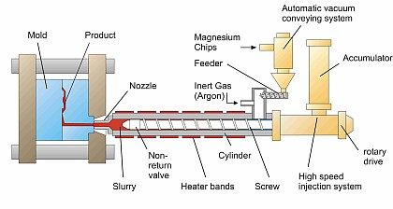

Thixomolding: Magnesium
Lightweight, high precision
electronic components (Mg)
Done from solid + liquid region of the phase diagram
http://www.thixomat.com/

Slide 28
Metal Fabrication Methods - III
FORMING
CASTING
JOINING
• Powder Metallurgy
(materials w/low ductility)
• Welding
(when one large part is
impractical)
pressure
filler metal (melted)
base
metal (melted)
fused base metal
heat
heat affected zone
area
unaffected
unaffected
contact
piece 1
piece 2
densify
• Heat affected zone:
(region in which the
microstructure has been
changed).
point contact
densification
at low T
by diffusion at
higher T

Slide 29
Thermal Processing of Metals
Annealing: Heat to Tanneal, then cool slowly.
•
Stress Relief: Reduce
•
Spheroidize
(steels):
stress caused by:
Make very soft steels for
-plastic deformation
good machining. Heat just
-non-uniform cooling
below T_{E} & hold for
-phase transform.
15-25 h.
Types of
•
Full Anneal
(steels):
Make soft steels for
Annealing
good forming by heating
to get
γ
, then cool in
•
Process Anneal:
furnace to get coarse P.
Negate effect of
•
Normalize
(steels):
cold working by
(recovery/
Deform steel with large
recrystallization)
grains, then normalize
to make grains small.

Slide 30
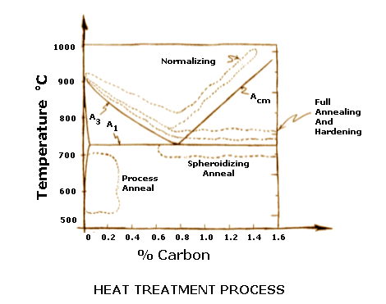
Annealing Temperatures
www.efunda.com

Slide 31
Ceramic Fabrication Methods-I
GLASS
FORMING
PARTICULATE FORMING
CEMENTATION
• Pressing:
Gob
Pressing
plates, dishes, cheap glasses
--mold is steel with graphite lining
operation
Parison
mold
• Fiber drawing:
• Blowing:
Compressed
air
suspended
Parison
Finishing
mold
wind up

Slide 32
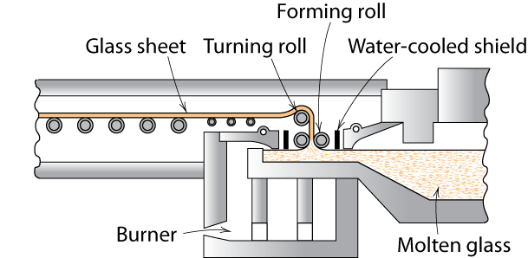
Sheet Glass Forming
Sheet forming – continuous draw
originally sheet glass was made by “floating” glass on a pool of mercury

Slide 33
Heat Treating Glass
• Annealing:
--removes internal stress caused by uneven cooling.
• Tempering:
--puts surface of glass part into compression
--suppresses growth of cracks from surface scratches.
--sequence:
before cooling
surface cooling
further cooled
cooler
compression
hot
hot
tension
cooler
compression
--Result: surface crack growth is suppressed.

Slide 34
Ceramic Fabrication Methods-IIA
GLASS FORMING
PARTICULATE
FORMING
CEMENTATION
• Milling and screening: desired particle size
• Mixing particles & water: produces a "slip"
• Form a "green" component
A
o
container
die holder
--Hydroplastic forming:
extrude the slip (e.g., into a pipe)
force
ram
billet
extrusion
A
d
--Slip casting:
container
die
pour slip
absorb water
pour slip
drain
“green
into mold
into mold
into mold
mold
ceramic”
“green
ceramic”
solid component
hollow component
• Dry and fire the component

Slide 35
Clay Composition
A mixture of components used
(50%) 1. Clay
(25%) 2. Filler – e.g. quartz (finely ground)
(25%) 3. Fluxing agent (Feldspar)
binds it together
aluminosilicates + K⁺, Na⁺, Ca⁺

Slide 36
Features of a Slip
Shear
• Clay is inexpensive
• Adding water to clay
-- allows material to shear easily
along weak van der Waals bonds
-- enables extrusion
-- enables slip casting
charge
neutral
weak van
der Waals
• Structure of
Kaolinite Clay:
bonding
charge
Si
4+
neutral
Al
3
+
OH
-
O
2-
Shear

Slide 37
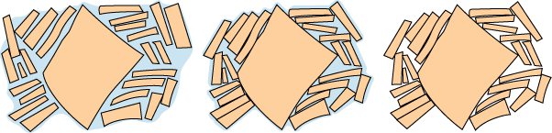
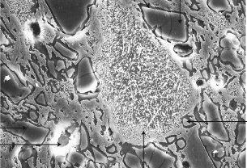
Drying and Firing
• Drying: layer size and spacing decrease.
wet slip
partially dry
“green” ceramic
Drying too fast causes sample to warp or crack due to non-uniform shrinkage
• Firing:
--T raised to (900-1400°C)
--vitrification: liquid glass forms from clay and flows between
SiO2 particles. Flux melts at lower T.
Si0₂ particle
(quartz)
micrograph of
glass formed
porcelain
around
the particle
70 μm

Slide 38
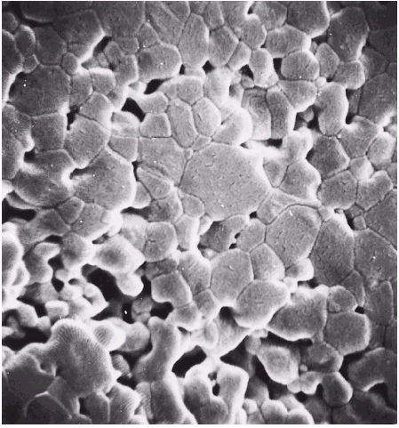
Ceramic Fabrication Methods-IIB
GLASS FORMING
PARTICULATE
FORMING
CEMENTATION
Sintering: useful for both clay and non-clay compositions.
• Procedure:
-- produce ceramic and/or glass particles by grinding
-- place particles in mold
-- press at elevated T to reduce pore size.
• Aluminum oxide powder:
-- sintered at 1700°C
for 6 minutes.
15 μm

Slide 39
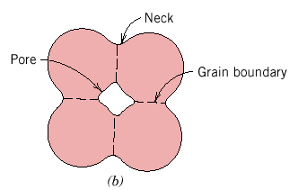
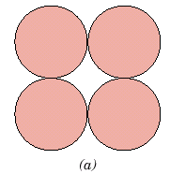
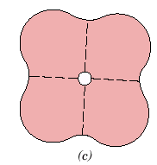
Powder Pressing
Sintering - powder touches - forms neck & gradually neck thickens
add processing aids to help form neck
little or no plastic deformation
Uniaxial compression - compacted in single direction
Isostatic (hydrostatic) compression - pressure applied by fluid - powder in rubber envelope
Hot pressing - pressure + heat

Slide 40
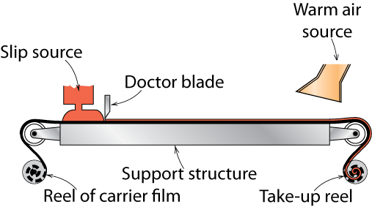
Tape Casting
thin sheets of green ceramic cast as flexible tape
used for integrated circuits and capacitors
cast from liquid slip (ceramic + organic solvent)

Slide 41
Ceramic Fabrication Methods-III
GLASS FORMING
PARTICULATE
FORMING
CEMENTATION
• Produced in extremely large quantities.
• Portland cement:
-- mix clay and lime bearing materials
-- calcinate limestone (heat to 1400 C: CaCO₃ -> CaO + H₂O)
-- primary constituents:
tri-calcium silicate (3CaO-SiO₂)
di-calcium silicate (2CaO-SiO₂)
• Adding water
-- produces a paste which hardens
-- hardening occurs due to hydration (chemical reactions
with the water CaO + H₂O -> Ca(OH)₂).
• Forming: done usually minutes after hydration begins.
Concrete: cement plus aggregate (gravel)

